Slide 1
FSR01CE-ND Force Sensing Resistor
Abshir Mohamud
Smart Solutions

Slide 2
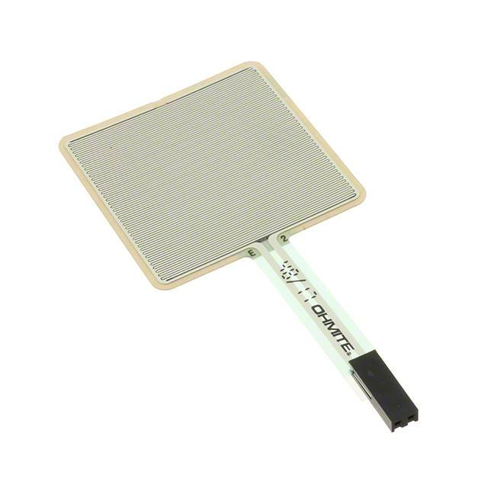
Introduction
Does not have polarity.
Range of Pressure applied can be specified for activation.
Simple circuit only requiring a resistor added on to the microcontroller.
Will be used for Smart Ping Pong Machine project next semester.

Slide 3
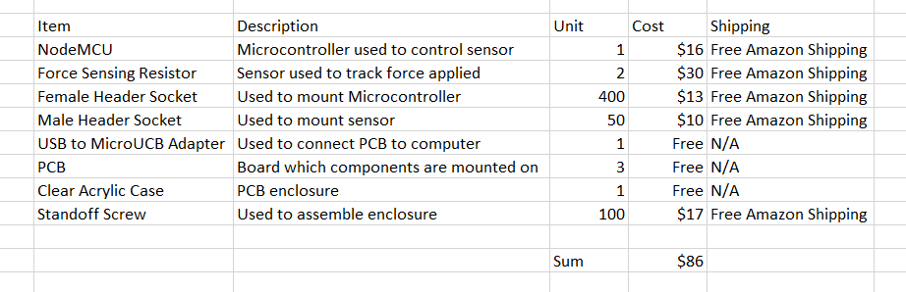
Budget

Slide 4
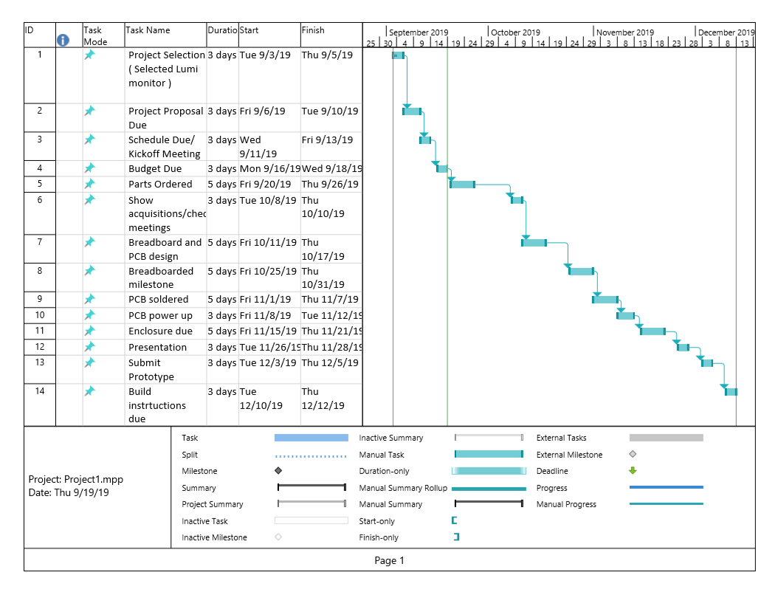
Schedule

Slide 5
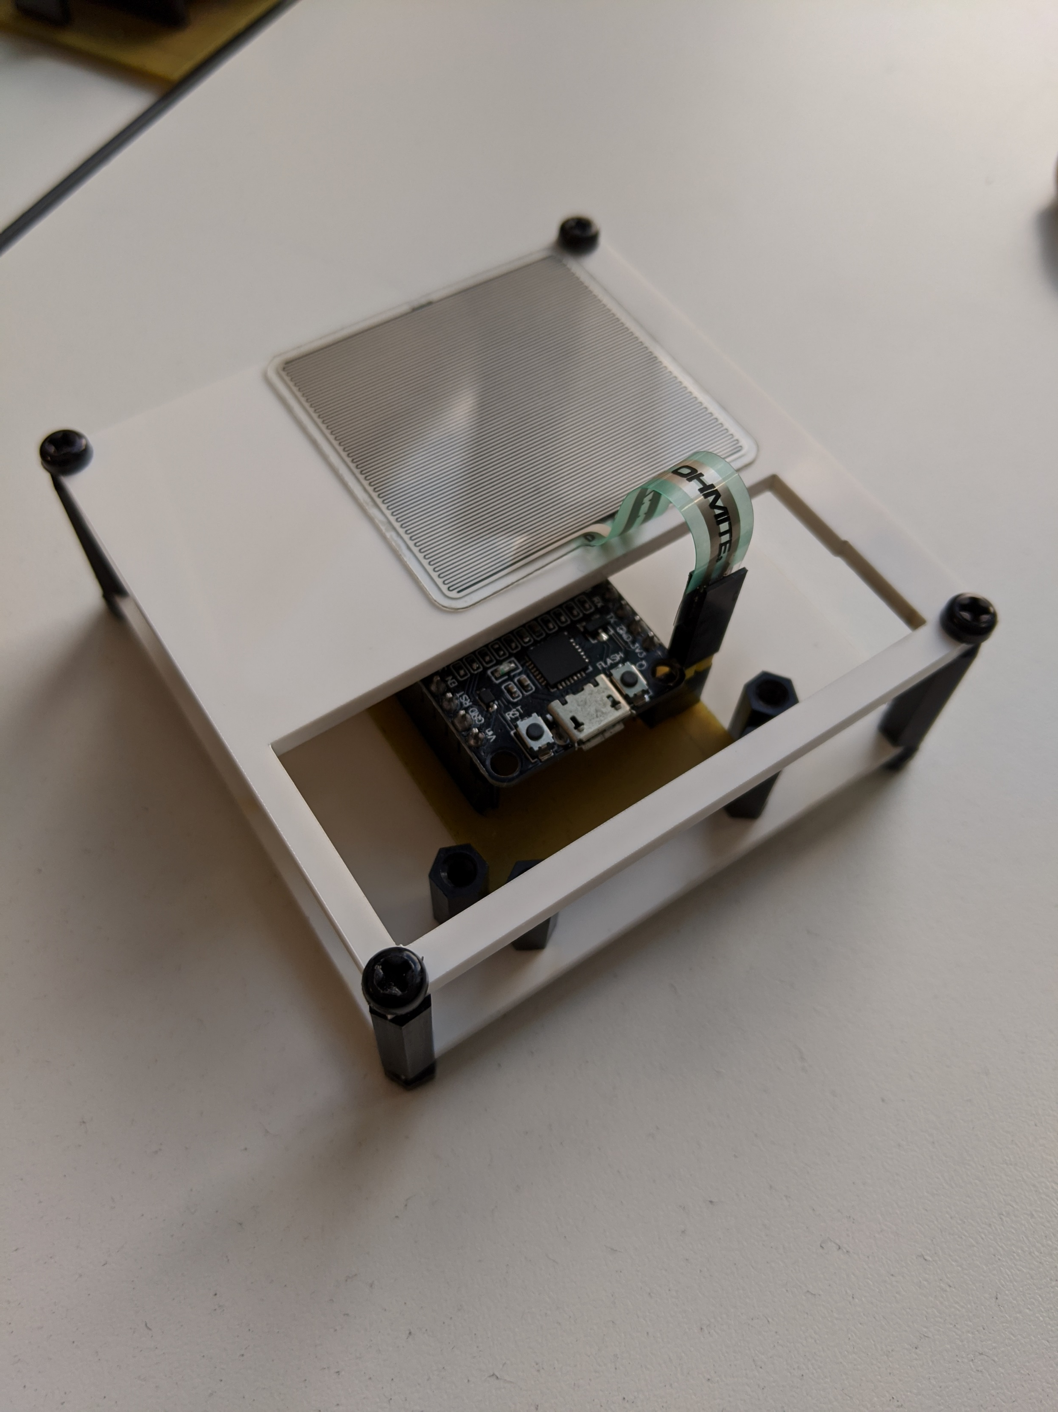
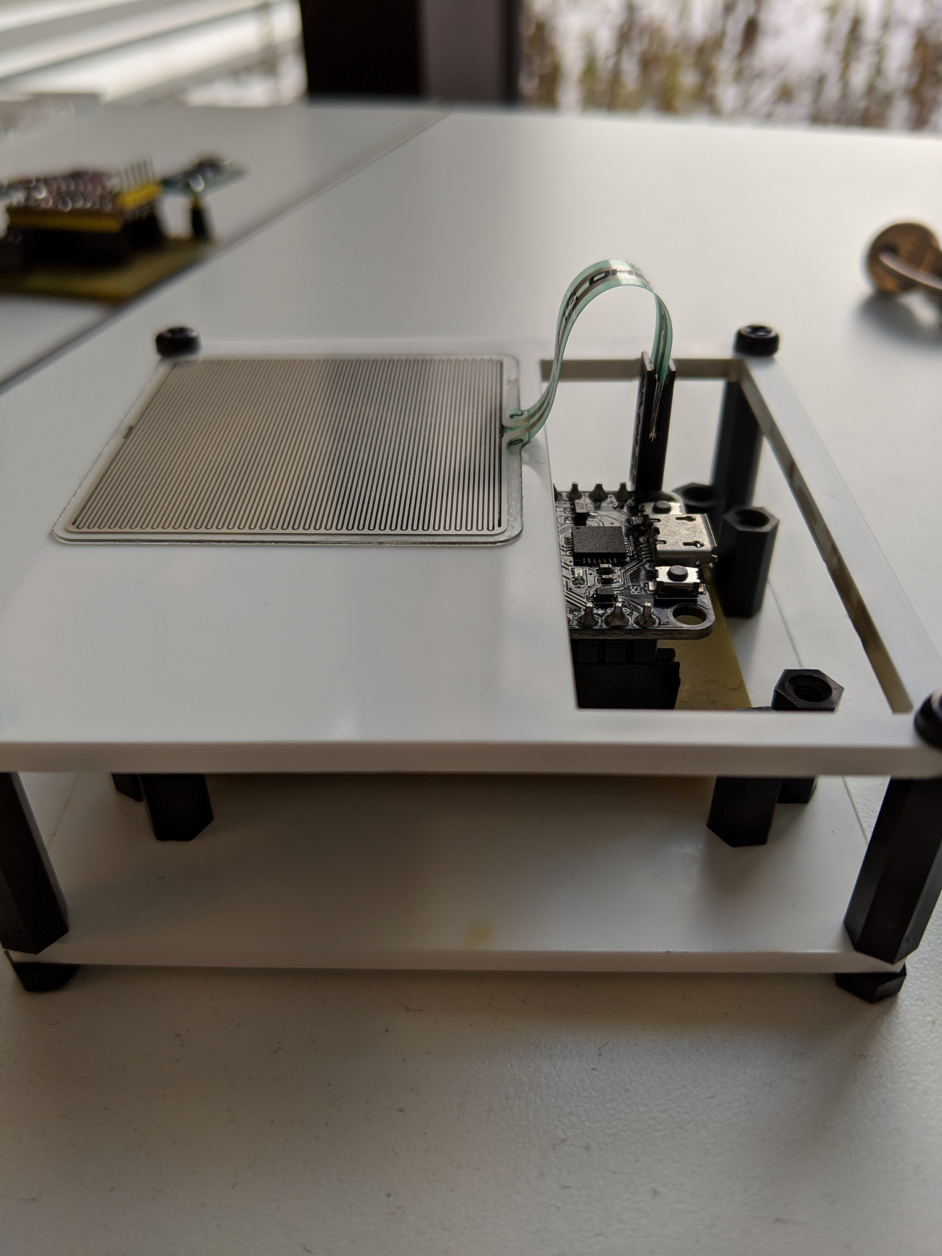
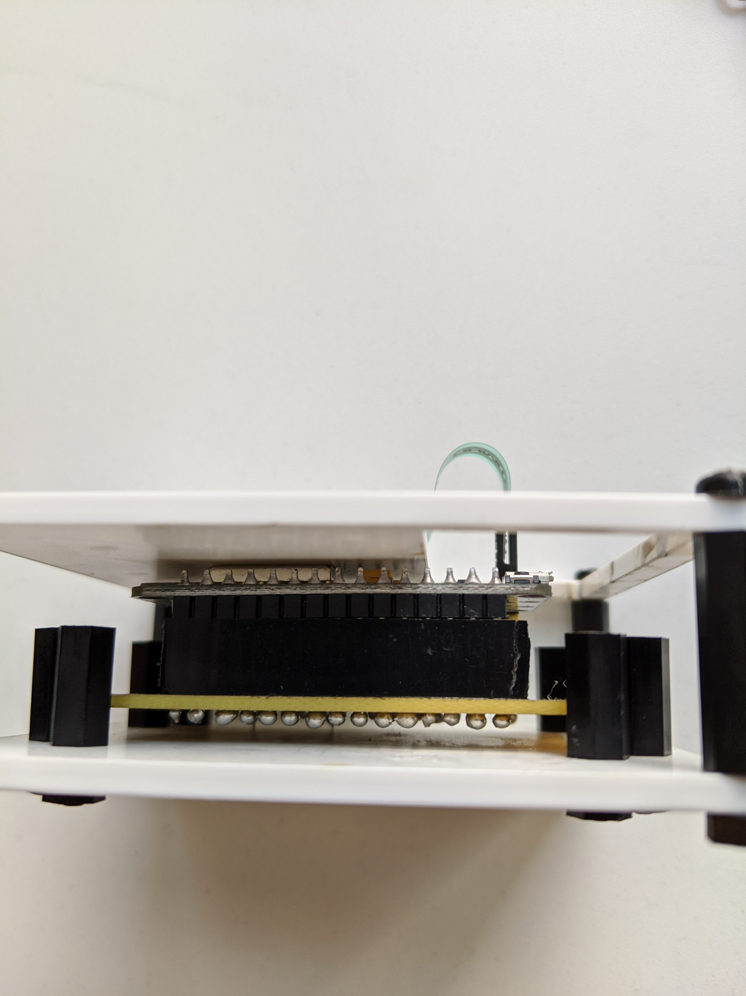
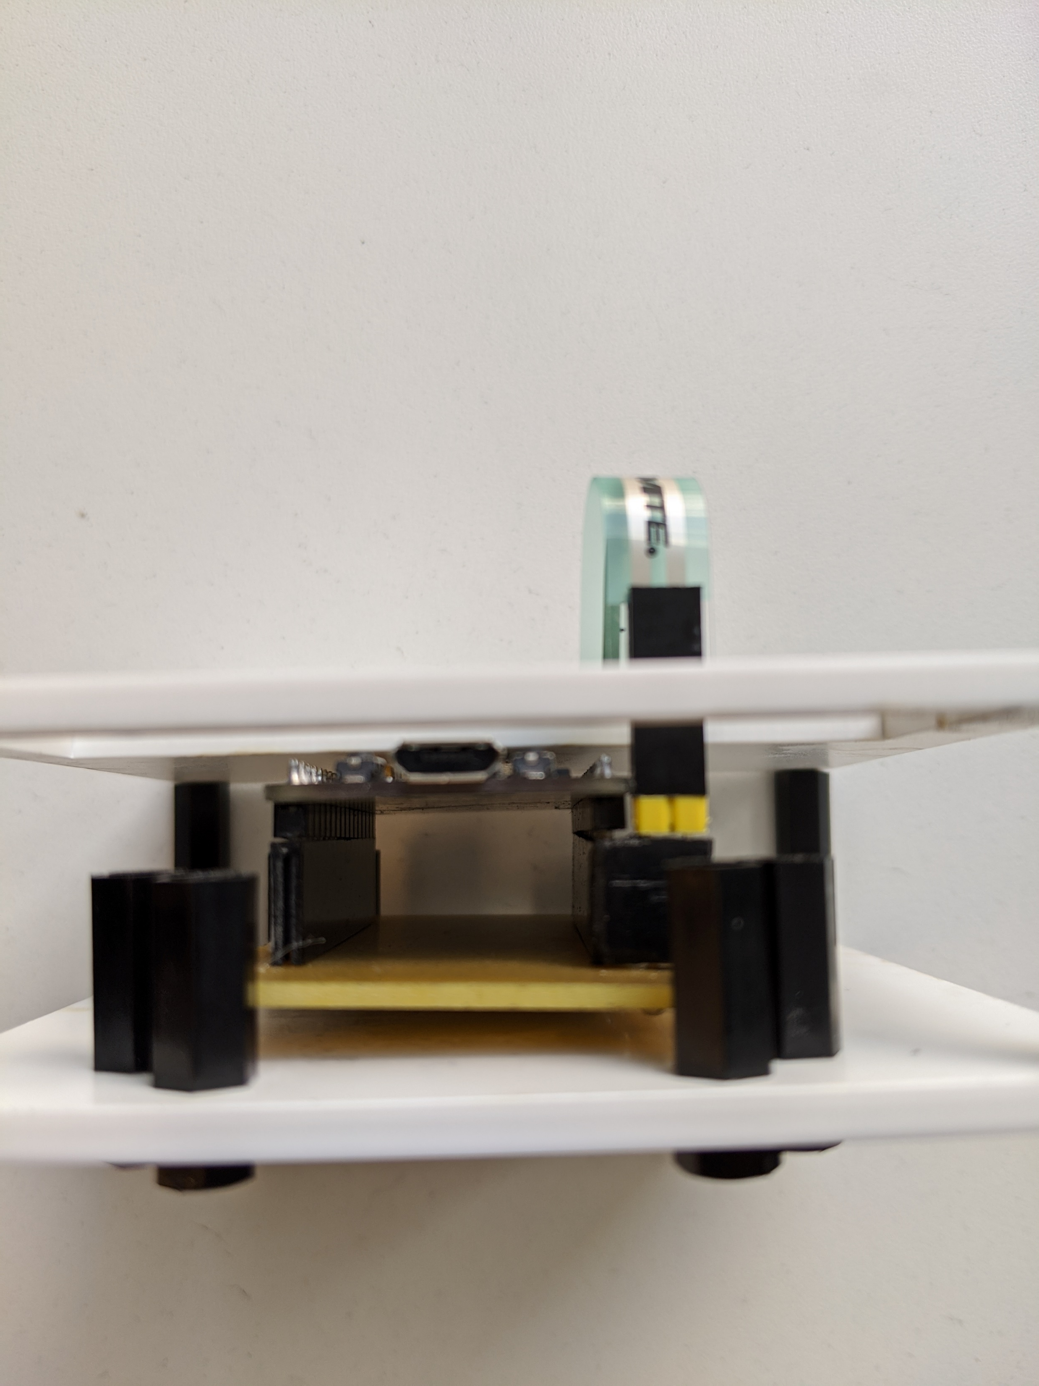
Project Image

Slide 6
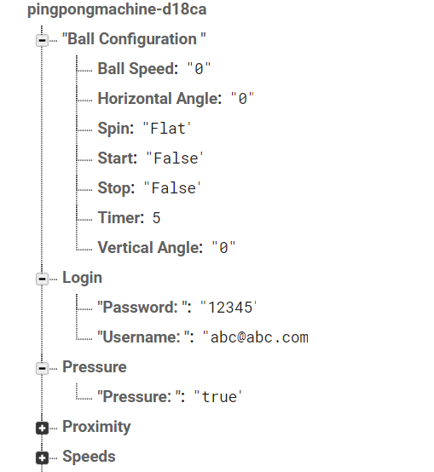
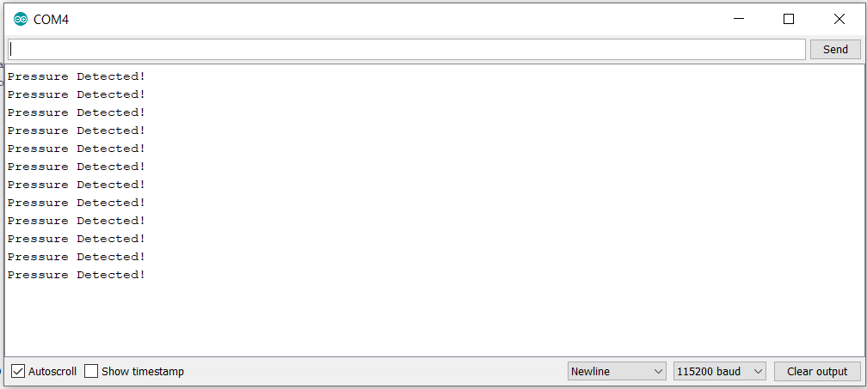
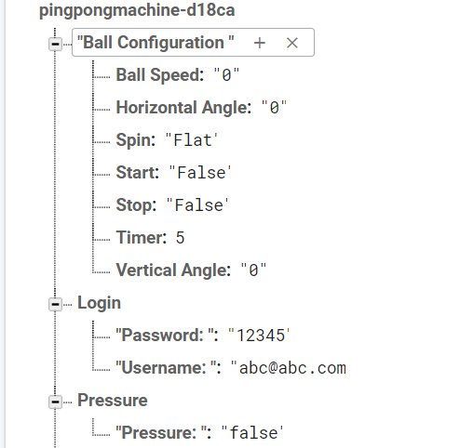
Sensor Reading

Slide 7
Previous course knowledge used
CENG317 Hardware Technology Production- Learnt how to solder
CENG216 Introductions to Software Engineering – Learn the basics of software development and making Gantt charts
CENG215 Digital and Interfacing Systems – Working with sensors.
TECH153 Technical C – Learnt advanced topics of C

Slide 8
Thank you for listening

